Slide 1
SIGMUND FREUD
IS THERE MORE TO US THAN WE THINK?
(OR PERHAPS LESS?)
Presentation to Pinner Philosophy Group
3rd December 2025
Peter Lawson

Slide 2

The Central Question
The question has been asked as to whether the premise should be re-worded to, "Is there less to us than we think"?
Although that reworded question might seem to mean the opposite, it can also be interpreted as the same question, alluding to the contention either way that what you see in another person, or what we see in ourselves, is not necessarily in line with reality.

Slide 3
Life & Context
(1856–1939)
Born in Moravia; raised in Vienna's Jewish community
20 Maresfield Gardens, NW3 is a wonderful empirical backdrop
Complex relationship with Judaism: described himself as a "godless Jew"
Yet identified with Jewish intellectual traditions and Talmudic hermeneutics
His emphasis on textual interpretation mirrors Jewish scholarship methods

Slide 4
Influence on Psychiatry
I often wonder how psychiatry and associated understandings about human beings would have been different had he not lived.
I have similar thoughts about all sorts of individuals down the years. I often conjecture about there being and there having been non-existent individuals who might have lived and changed the world.
British awareness of him might have been different had he not lived here at the very end of his life.

Slide 5
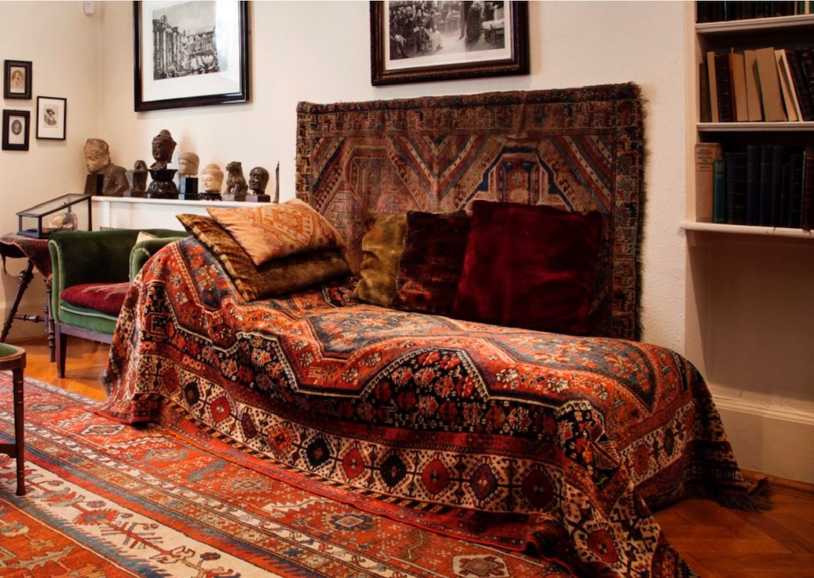

Slide 6
The Paradox: Breaking Down Preconception
There is a fascinating disjunction: he breaks down preconception in his patients and facilitates the emergence of a new gestalt within them, yet hangs rigidly onto his own diagnostic frameworks.
He allows himself to be hidebound by learnt attitudes and behaviours, while proscribing the same in his patients. How well did he even know himself?

Slide 7
His Own Childhood
Eight children in the family, six siblings
Sigmund had his own room in a 3-bedroom apartment
As a child he complained about noise of his sister's piano practice
The bulky Steinway was gone in 24 hours
It was said he never questioned his own solipsism in this and other connections

Slide 8
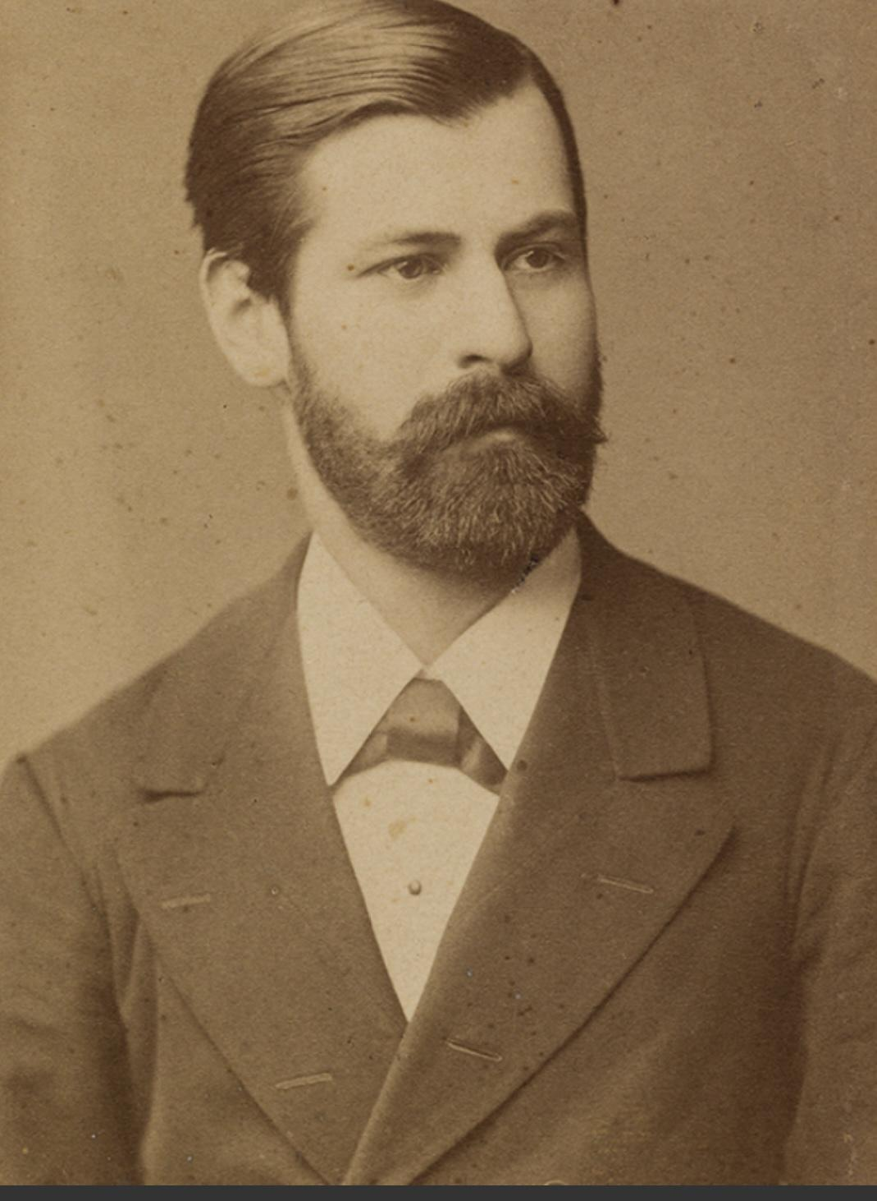

Slide 9
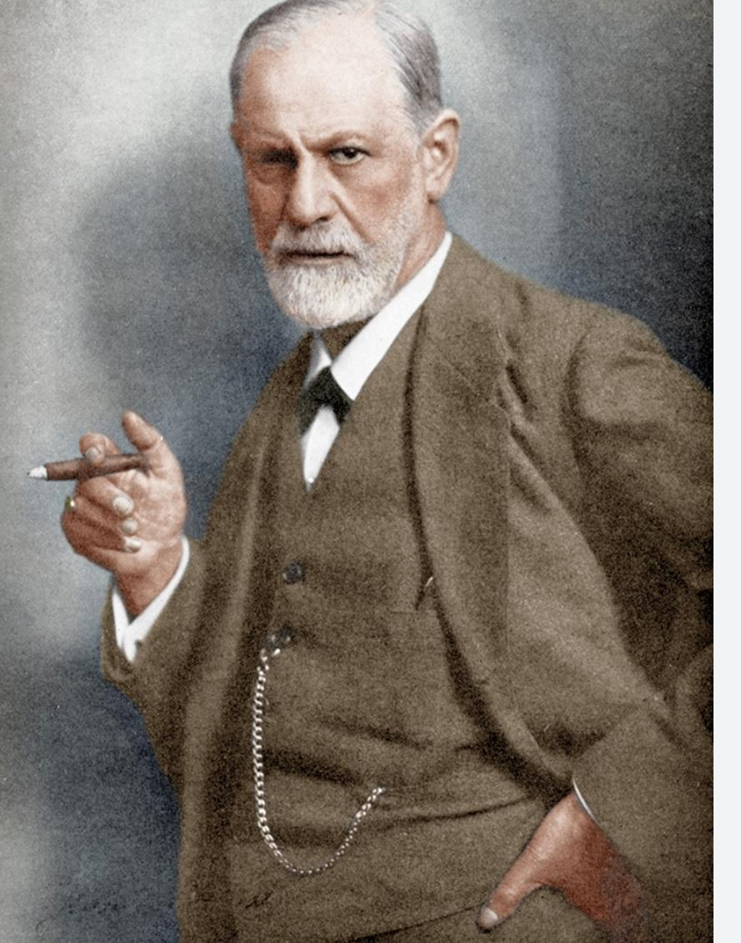

Slide 10
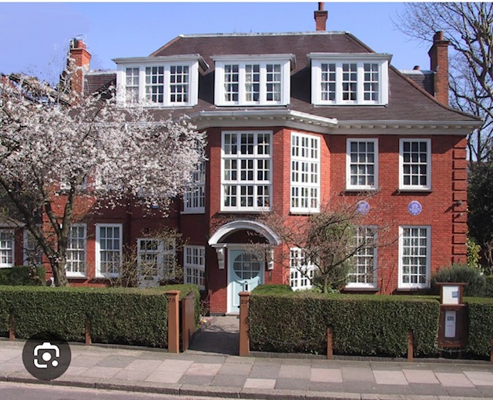
20 Maresfield Gardens

Slide 11
Early Influence: Jean-Martin Charcot
Freud started in neurology
Spent several months at age 29 studying under Charcot in Paris
Developed understanding of hysteria and hypnosis
He called his first son Jean-Martin

Slide 12
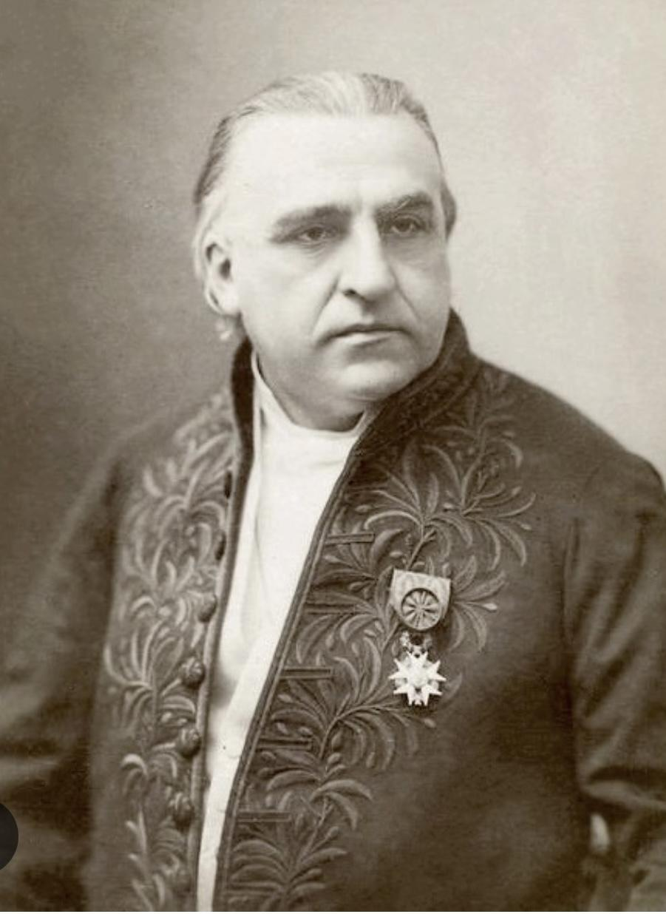
J-M Charcot

Slide 13
The Shift: Neurology to Psychology
Legitimising psychological causes: Physical and organic illness have psychological roots. Essential relationship between auto-suggestion and pathology.
Power of the unconscious: Half the time we've no idea why we feel as we do—a hijacking of consciousness and physical body.
The talking cure: The mapping of id, ego and superego. Structure and dynamics of the self.

Slide 14
The Body and Frame of Mind
We all know that the body can change its constitution derivative from frame of mind: headaches, arousal, bowel movement, sweating.
From the moment Freud began using hypnosis, mainly treating "hysterical women", he claimed he cured them. Symptoms have causes that are not physical.

Slide 15
On Hysteria
Hysteria: not just in a philological sense, but in a semantic one too—is this word misogynistic?
What about emotional gerrymandering in the attribution of hysteria? Good Friday story.
Symptoms have causes that are not physical . (Holland & Barratt story)
While in France, Freud could not persuade Parisians he was speaking comprehensible French. (Speak more loudly; they’ll understand.)
Once again, how well did he even know himself?

Slide 16
Psychosexual Development (Controversial)
The psychosexual stages of development have taken the most notable kicking. Much of this is conjectural at best.
The Oral Phase: First of all. Taking pleasure from operating via the mouth. Various embodiments: sucking, eating, shouting, etc.
The Anal Stage (1 to 3 years): Anally retentive and expulsive. There is more sense here. Strange that the word 'anal' is so much a part of contemporary language.

Slide 17
On Anal Retentiveness
Some have argued that capitalism—while being entirely defensible economically—can easily subside into, and be attributed to, retentiveness.
Computers can be said to be retentive of information; a useful paradigm to see the positives and negatives.
Freud argued that retentiveness is not just a constipational negative.
It can be positive, acting as a repository allowing the child to be a mannequin and make of him or herself what they will.

Slide 18
The Phallic Stage
Ages 3 to 6, with the Oedipal/Electra stage beginning at ages 4 or 5 in boys
Sexual desire is desire to possess
Father as rival; father senses and fears castration
This impedes the father/son relationship

Slide 19
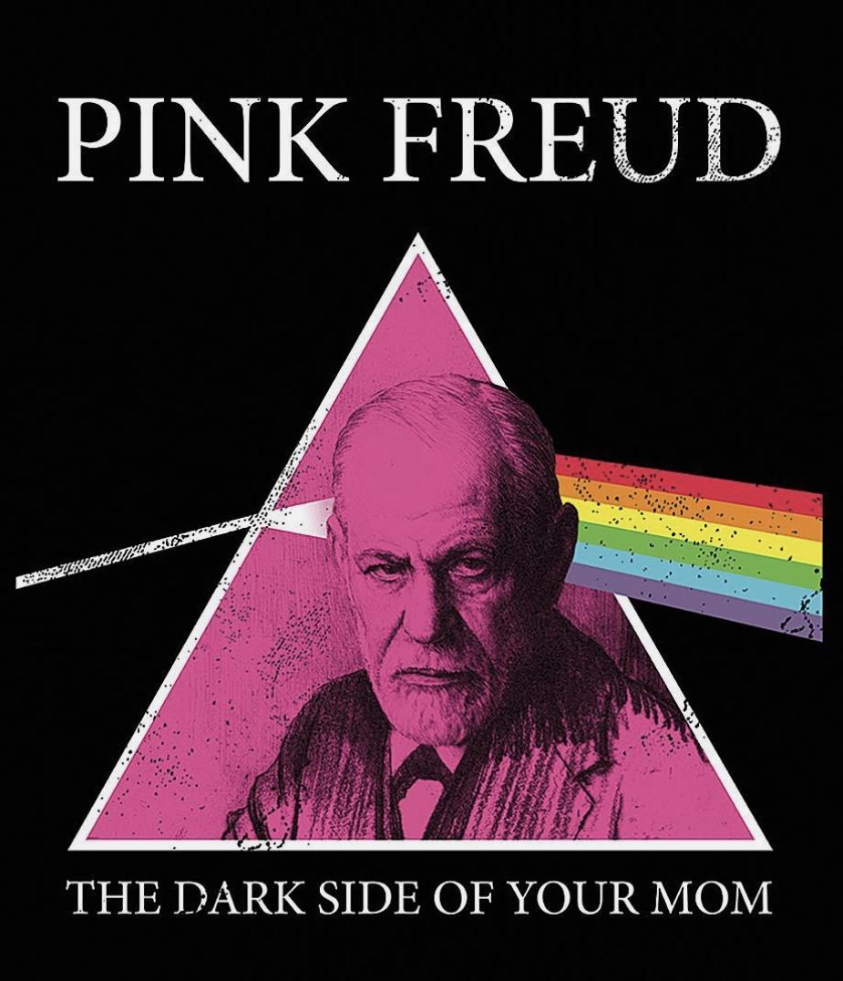

Slide 20
Latency Stage
Latency is pre-pubescent. Sublimation of sexualised urges. The individual constructs a calm before the adolescent storm by committing to activities such as sport and schoolwork.

Slide 21
Key Objections
Lack of empirical evidence for these stages
Strange that someone so disposed to analysing nuances failed to account for cultural differences
No room for differences from New York to Papua New Guinea; nor from ancient times to modern
A centricity about heterosexuality in Freud's constructs

Slide 22
In Defence of Pioneering Genius
It's too easy to criticise creativity with hindsight. We must build tolerance into our critiques that such a pioneering genius was going to make mistakes.
Ernest Rutherford was a pioneering researcher in atomic physics, but he made errors revealed by successors. These should not be a green light for researchers to traduce those who came before with astonishing insight. Churlish and insulting.

Slide 23
Freud & Homosexuality
Centricity about heterosexuality in Freud's constructs
Conservative and censorious in context of homosexuality
Later became more tolerant
His own daughter Anna was probably a lesbian, conducting an affair with Dorothy Burlingham
Unclear whether changing tides of his mind were independent or predicated on personal connection

Slide 24
Consciousness: Three Levels
Conscious: What we are aware of
Preconscious: Extension to conscious (having someone's phone number in the back of your mind you can readily retrieve)
Unconscious: The element which evinces a self not known to oneself

Slide 25
The Consciousness as Iceberg
Abuse and ill-treatment until age 3: no memory of it, but patterning of one's life according to it
As for what's below the visibility line, it could be said to be a riddle wrapped in a mystery, inside an enigma
Possibility that with maturation, your person enables the healing with time of wounds caused by trauma
Why necessarily would you want to bash off all the scabs that have organically formed as your knees' guardian angel?

Slide 26
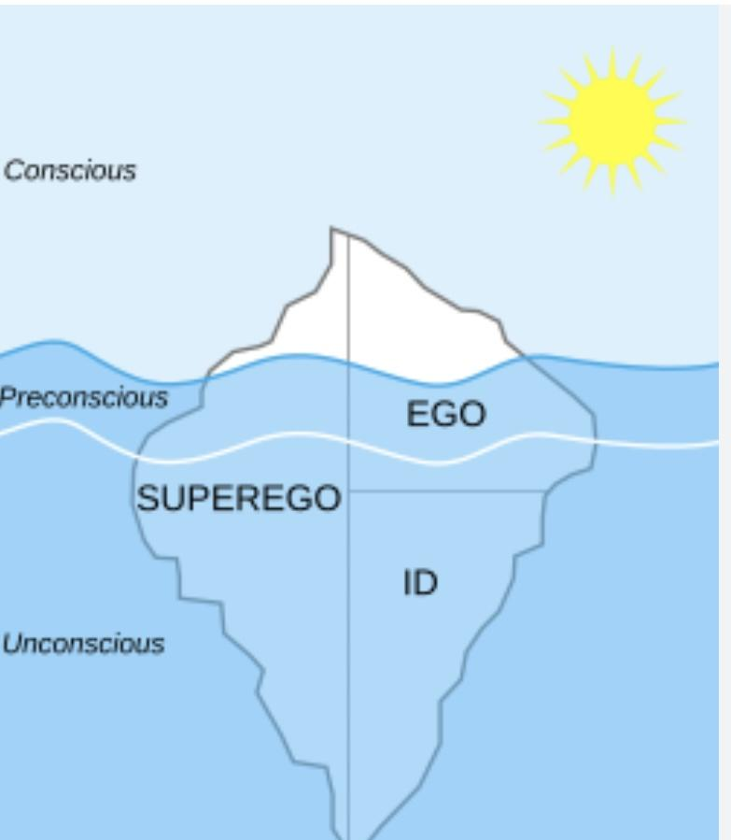

Slide 27
Hypnosis as Revelator
Does it work? Not for me, unfortunately.
People isolate hypnosis into a hidebound and bewitching context as something done by psychiatrists or comedians with pocket watches
Semi-hypnosis of journey to work or reading a boring book
To be hoped that the genie released is one who is curative if not preventative

Slide 28
Therapeutic Hypnosis & the Bogeyman
The goal of therapeutic hypnosis: the bogeyman of one's life took up residence in one's psyche at a stage when a child was unable to sift, doubt and process the authenticity of the bogeyman.
It becomes concretised by lack of therapeutic attention, force of habit, and nursing of them as false friends. They introduce neurosis which the patient clings onto for fear of finding worse if released into the ether.
There are many evil people out there who plant these demons. Ambulance chasers.
In thew context of our myriad fallibilities and epistemological impotence, we are always like to be that vulnerable child

Slide 29
Religious Dogma & Consciousness
Religious dogma defines the prescribed consciousness of the deity required by orthodoxy
Over-simplistic, especially regarding sleep, amnesia, dementia—during which prescribed consciousness is not there
Believers often say God takes everything into account, but this contradicts the bald question: "Have you adopted Christ as your redeemer? Yes or no?"

Slide 30
Freudian Slips: Parapraxes
Slips represent confusion between two iterations of ourselves
Perhaps redolent of Jung's 'Shadow Self'
The slip reveals something unspoken or unknown to the utterer
The unconscious mind finds expression for the slip of the tongue (spoonerised)
MP from Hull Central. Victoria Derbyshire
Tram story
JP Morgan story

Slide 31
Minna Bernays
Without conclusive evidence, there was much gossip about an affair Sigmund had with Minna Bernays, who was far more intellectual than her Hausfrau sister, Martha.
Story of Clamence in ‘La Chute’ by Albert Camus. Casuistry; cognitive dissonance

Slide 32
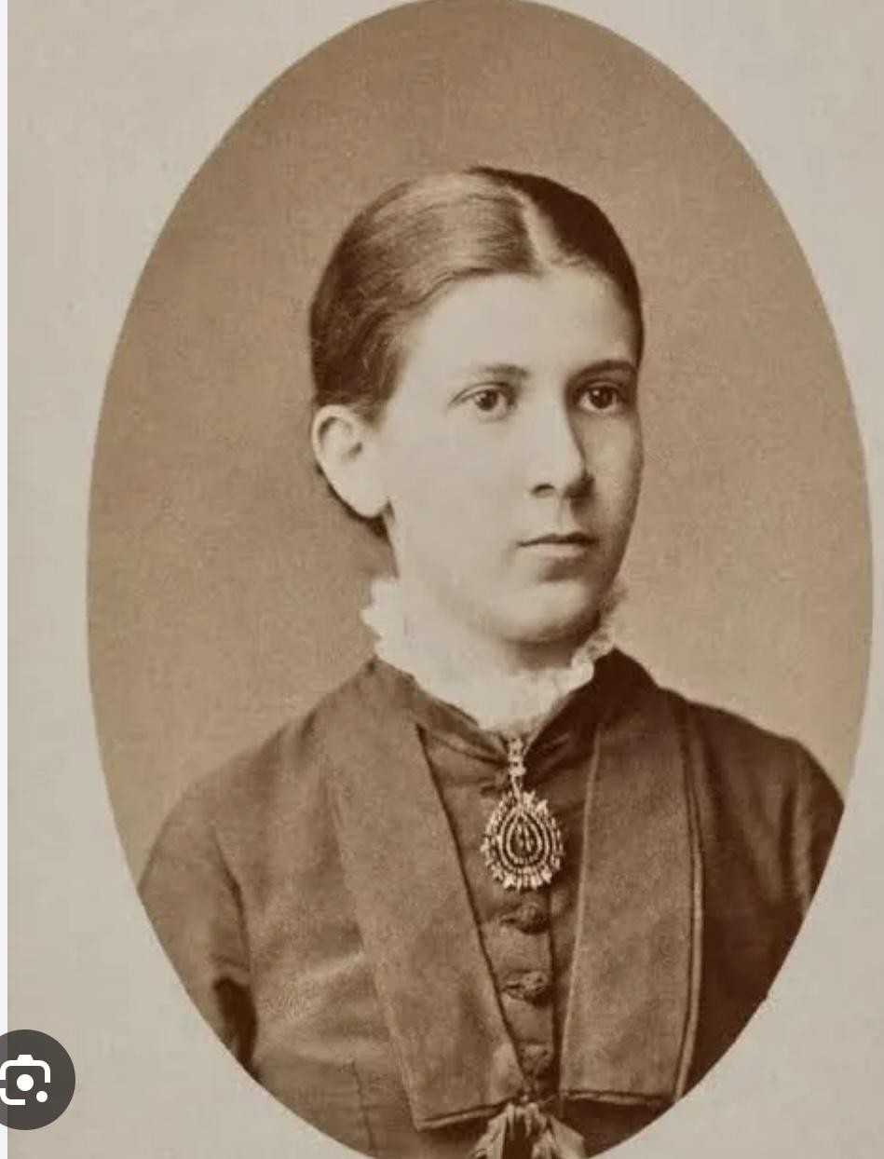
Minna Bernays

Slide 33
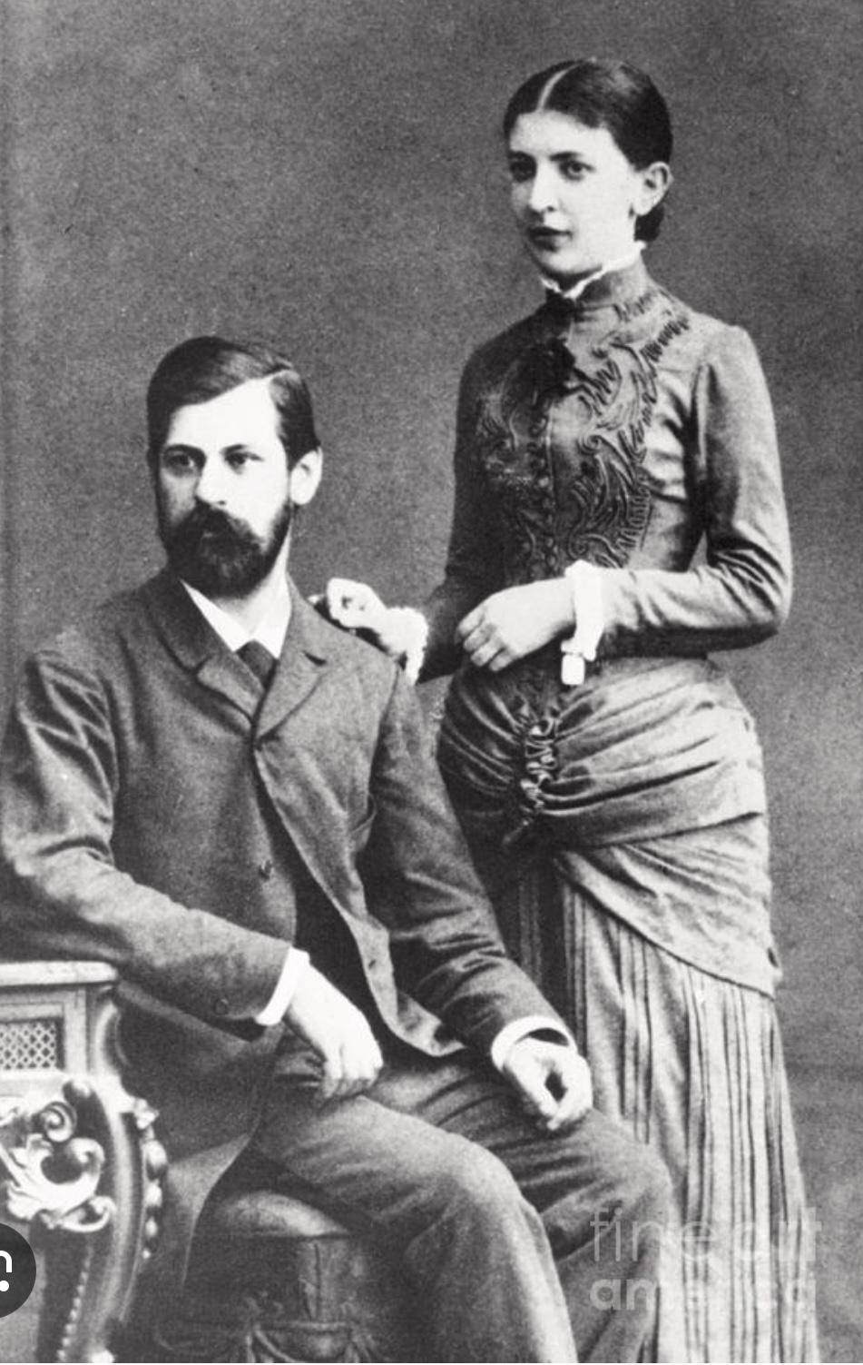
Sigmund mit Martha

Slide 34
William James
(1842–1910)
"A man has as many social selves as there are distinct groups of people."
We have glaring contradictions even at a conscious level, and attendant duplicity.

Slide 35
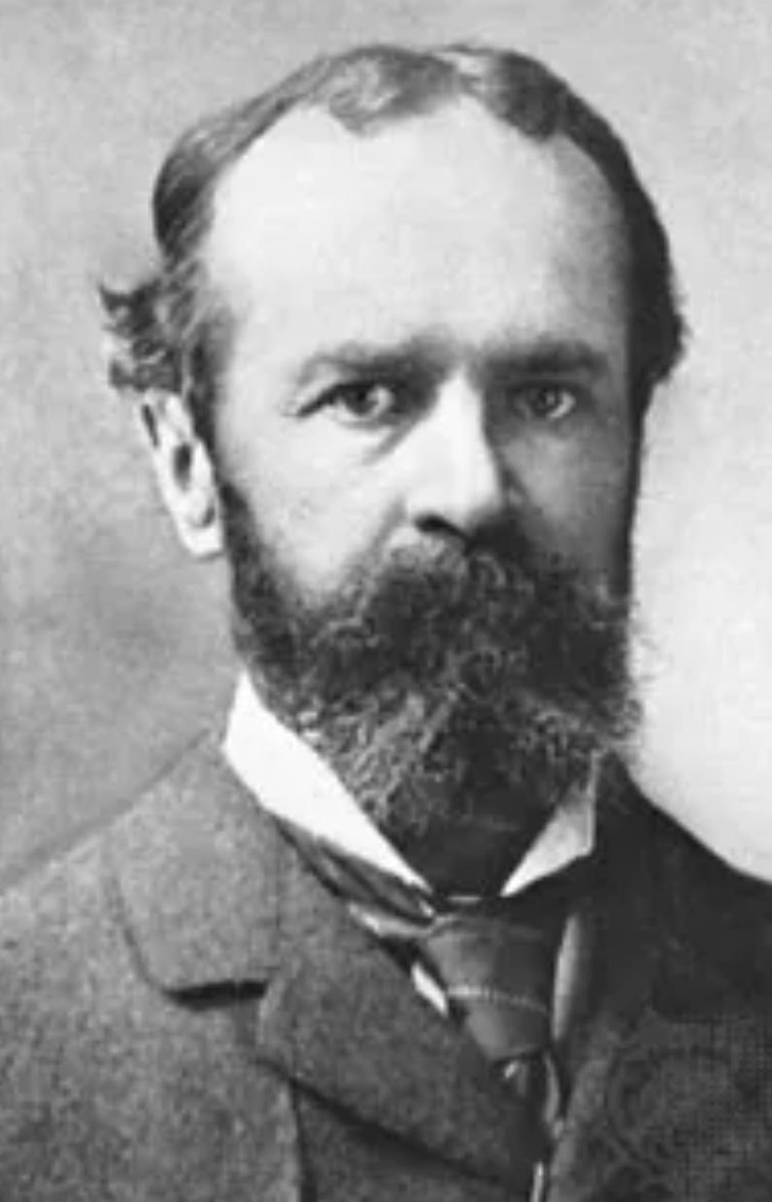
William James

Slide 36
Multiple Personas
First awareness of this at university—not knowing how to mix discrete friendship groups
Our diction, phrasing and spoken register alter depending on interlocutor
Is this pusillanimous and hypocritical or pragmatic and considerate?
We all adopt the personas of those around us, and hope they counterbalance by copying us
Social proof; consensus validation

Slide 37
Truthfulness
It is taken as an axiom that truthfulness is the best option in life, firstly on an ethical basis (thereby humanising), but also on a practical level—it is easy to forget which lies one has told to whom.

Slide 38
The Surface Self
Music tastes: we adopt different personas regarding aesthetic preference
Traffic behaviour: we hide who we are as pedestrians (YouTube video)
Grammatical correctness: I have two personas
Judging physical appearance: one where I judge criteria (tattoos etc); one where I do not

Slide 39
On Crying
We recently saw Rachel Reeves and Penny Mordaunt in tears in the House of Commons. The notion that women are weaker emotionally than men is preposterous, so what is going on here?
I tend to the view that by suppressing their tears, men are repressing themselves.

Slide 40
https://www.youtube.com/shorts/USecYdDob18?app=desktop&cbrd=1&ucbcb=1

Slide 41
The Paradox of Generosity
Generosity is so rewarding to be generous. This is counterintuitive from the point of being happy owing to a dwindling bank balance, but endorphins flow very pleasingly in ourselves when generous.

Slide 42
On Saying "I'm Sorry"
One of the centralities of the hypocrisy of the double persona is embodied in "I'm sorry"
Much of the time we mean "I'm sorry I was caught out"
We also allow ourselves to self-refract into a different individual depending on circumstance
Woody Allen story

Slide 43
The Psychopathology of Everyday Life (1901–1904)
Considering numerous cases of deviations, Freud concludes the boundary between normal and abnormal psyche is unstable—we are all a bit neurotic.
Such symptoms disrupt eating, sexual relations, work, and communication. The pathology unseats and hijacks the original self. Freud noted there is no limit to how long unconscious imagery dwells in the psyche.
Within years, the book became well-known. When at sea to the USA in 1909, Freud noticed his cabin boy had a copy. (Einstein story)

Slide 44
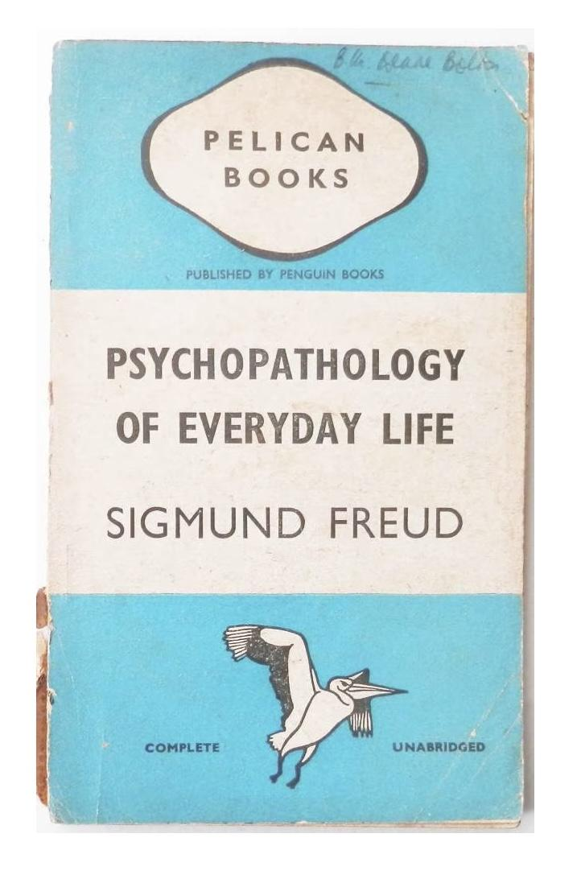

Slide 45


Slide 46
Hysteria & Mass Pathology
Witch hunts, The Crucible (Arthur Miller), Pogroms, Beatles' records being burnt
Hysteria is real, as is the attendant refraction splintering of personality
(Though imputation solely to women is absurd)
We sometimes do not face our own hypocrisy, adhering to morally upstanding ethics in one context while failing to hold to such laudatory ethics in an analogous situation. (Beckham scenario)

Slide 47
The Societal Self
We all have a public self which is curated and at odds with the self we share with ourselves. This societal self is almost always more prudish and less prurient than the self we do not share.
A chief reason: we have a default not to stray from safe, collective positions of morality.

Slide 48
On Language & Censorship
Asterisks in print replace language we fear might betray vulgarity
Euphemisms like "the N word" or "the C word" play the same role
All language when used abusively could be effaced, but reporting news should not be fettered
Words themselves carry no meaning—offensive or otherwise
It is not the word that is offensive; it is the connotation

Slide 49
Reporters' Duty
Reporters should have a duty to say or write what has happened, all the more so if something offensive has been said or written.
It is often said readers' and listeners' sensitivities must be respected in reporting. But by this token, the words Hitler and Auschwitz should also be asterisked.
Letter to The Times as follows:

Slide 50
Editorial Style
Sir, In your editorial about a backbencher’s response to the budget yesterday, you wrote that he had called the Chancellor a p****. Could I ask whether you meant a p**** or a p****?

Slide 51
How Easily Our Emotions Are Manipulated
It is relatively straightforward to demonstrate how easily manipulatable our emotions are by circumstance.
Two versions of a story about a housefire yield very different emotional responses.

Slide 52
Nazism: Evil Beneath Respectability
The social self can be a mask covering one's evil underneath. There is a remarkable documentary by Alain Resnais (1955): "Nuit et Brouillard" (30 minutes).
Regarding the social self, what is shocking is the insidiousness of Nazism—the self-conferred licence of respectability was precisely the anaesthetising influence on their conscience that allowed them to do what they did.
Two photos follow

Slide 53
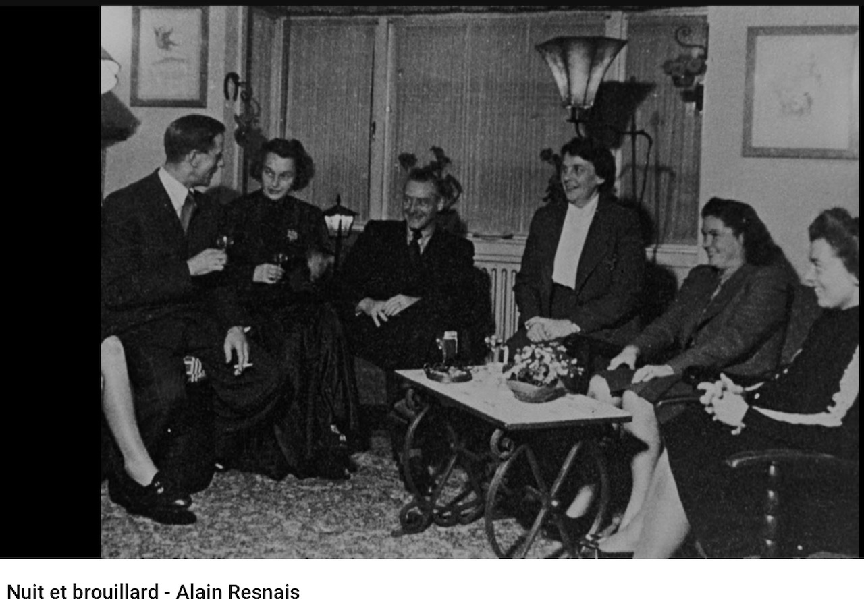

Slide 54
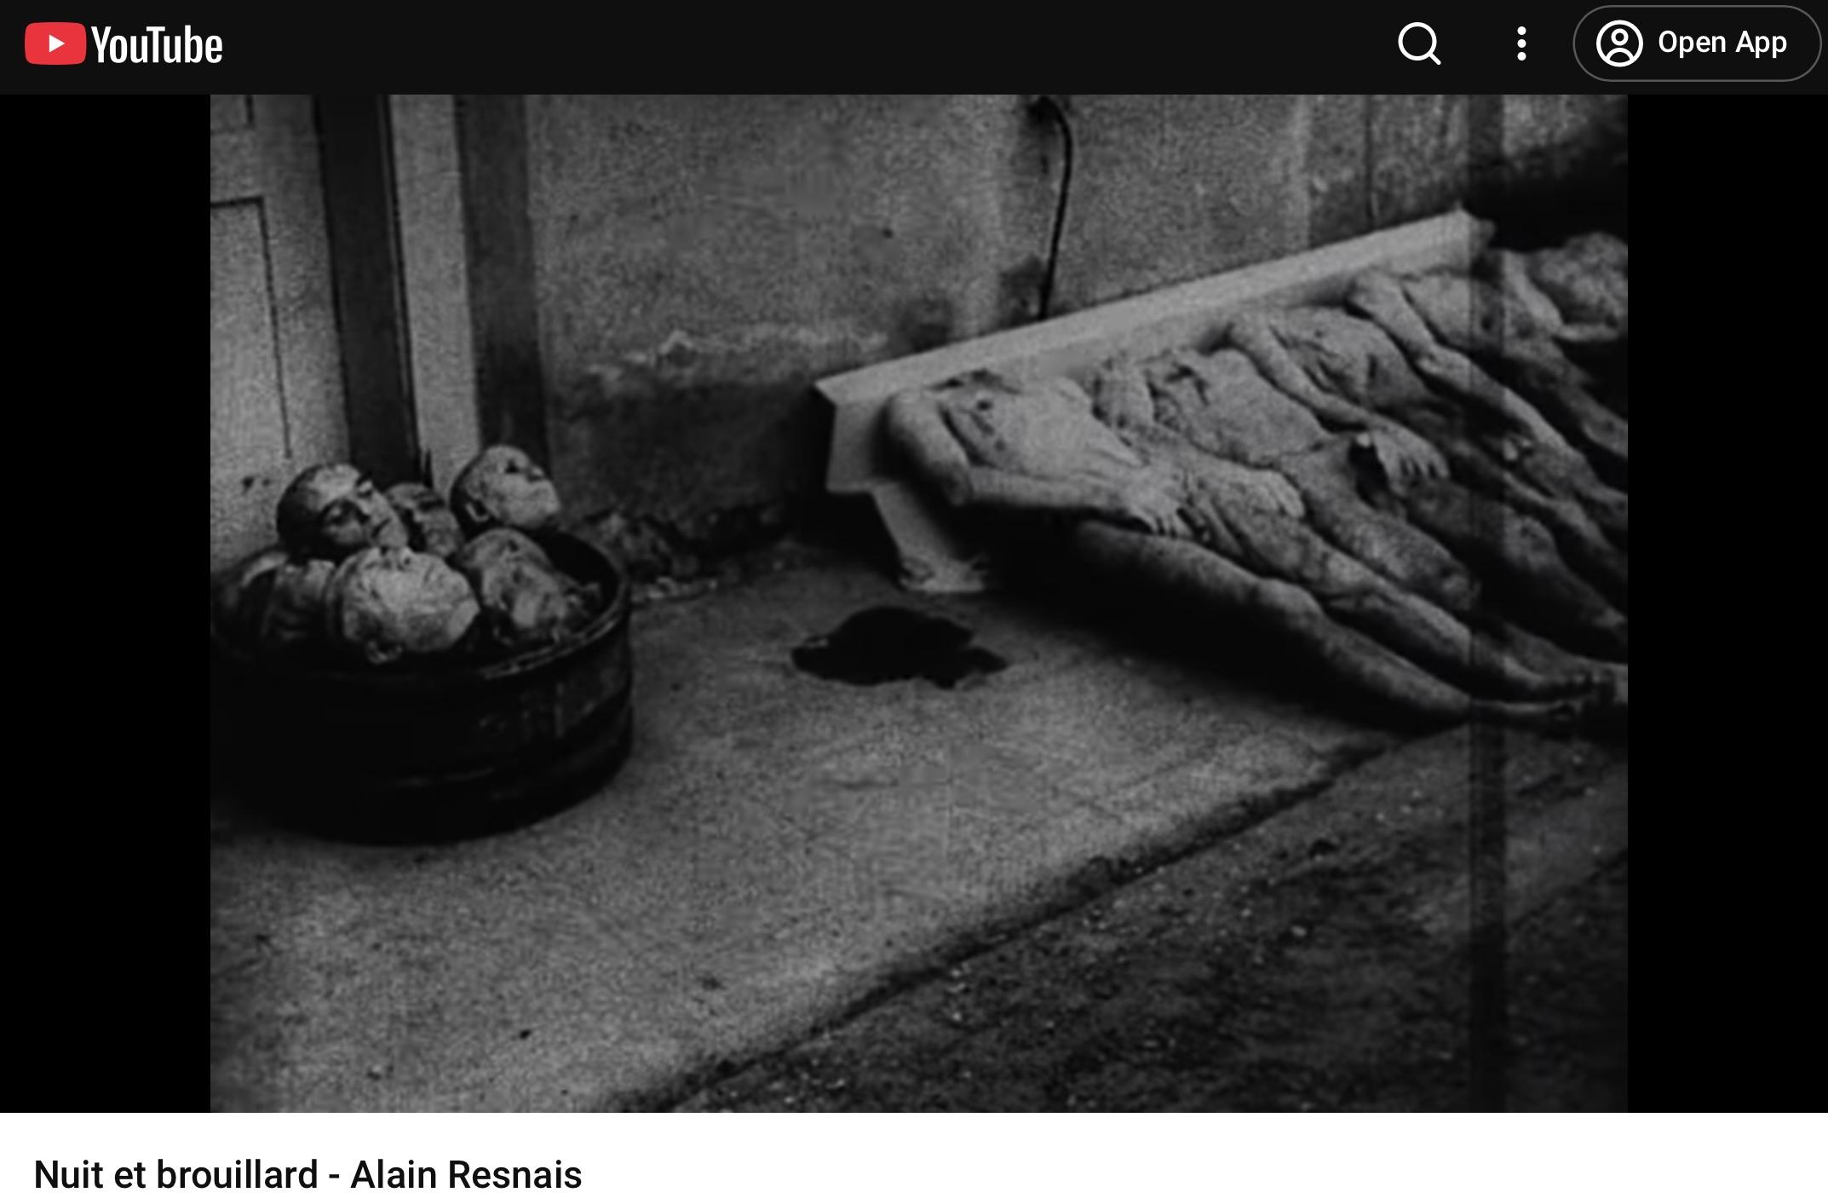

Slide 55
Dreams
Wish fulfilment is self-evidently an aspect of oneself not played out in everyday life. The classic Freudian interpretation is that dreams embody wish fulfilment.
From personal experience, I must disagree. I find them preponderantly to figure a dreaded scenario. Leitmotif dreams reveal persistent fears. Rugby and herrings are not to you what they are to me.

Slide 56
Reality as Perception
Reality is perceptual, not objective. If I got a broken nose playing rugby and don't like rugby, I won't perceive it reflective of another person's perception.
This is a Proustian idea. Everyone knows about the madeleine cake.
Our adopted self shifts significantly, contingent either on others' perception or on our own perception at different times or circumstances.

Slide 57
The Ego Not Master
"The ego is not master in its own house"
Painting a self buffeted by waves of circumstance, it is hardly surprising Freud wrote this. We are not unified, transparent beings.

Slide 58
Id, Ego & Superego
Later developed into the tripartite model, illustrating we are not unified beings. Instead, we are battlegrounds of competing forces most of which operate outside awareness.

Slide 59
The Id: The Hidden Engine
Unconscious and not directly experienced by us
Primitive instinct tool present from birth
Operates on the pleasure principle
Contains raw sexual and aggressive drives, basic needs and desires
Not concerned with reality, morality or consequences—just instant gratification
When you feel inexplicable surge of anger or inappropriate attraction—this is the id pushing from below

Slide 60
The Superego: The Internalised Judge
Largely unconscious
Develops through childhood as we internalise parents and society's moral standards
Our conscience and embodies what we aspire to be
We do not often realise why we feel guilt, shame or anxiety
Operates like internal critic we cannot switch off, punishing us with feelings we cannot always interpret

Slide 61
The Ego: The Struggling Mediator
Partly conscious, partly unconscious
Attempts to balance demands of id and moral constraints of superego
The ego uses defence mechanisms
Relatively easy to track when conscious, but most operate unconsciously
You don't decide to deploy denial or repression—they happen automatically
These protect from anxiety hovering just out of awareness

Slide 62
Homosexuality & Social Validation
Most people recognise homosexuality is more apparent now. Partly attributable to decriminalisation in UK (1967). Mainstream acceptability has validated many people coming out who yesteryear would have repressed who they were.
Such release buttons are to be cherished. I sense preponderance in society that homophobia is ludicrous.

Slide 63
Freud's Revolutionary Model
What we think we are—our conscious rational self—is the ego's conscious aspect trying to navigate between forces of which we are not fully aware.
The person we present to others, and even to ourselves, is a compromise formation. Our actual motivations, true desires and fears are largely hidden.

Slide 64
Self-Knowledge & Hidden Forces
For Freud, self-knowledge requires excavation given the conscious mind is routinely involved in acts of self-deception. Elemental acts such as choice of life partner are often engaged in according to these hidden factors.
He believed we are mysteries to ourselves, conscious intentions are post hoc rationalisations, and genuine self-understanding requires looking beneath surface at forces we might prefer not to see.

Slide 65
Post Hoc Rationalisations
We create plausible explanations for our behaviour after the fact without realising unconscious motives that have driven us. It is a network of internalised sophistry.

Slide 66
Case Study: The Cold Woman
A man with a censorious, critical mother finds himself attracted to cold, emotionally unavailable women who treat him poorly. When questioned, he says he likes independent, strong women, he likes a challenge, and other women are too clinging.
Freud might say the man is compulsively trying to win love and approval he never got from his mother, unconsciously attempting to resolve that childhood wound. The rational explanation protects from uncomfortable truths.

Slide 67
More Examples
threatened by that person
Forgetting a dental appointment because one is scared of drills
Criticising a trait in somebody that they unconsciously possess themselves, believing they are just being honest (projection)
Alligators in front garden

Slide 68
Irish Hospitality
I often wonder about Hitler or Stalin being prepared to be psychoanalysed. When looking at footage of Martin McGuinness and Ian Paisley breaking bread together, I wonder of they had been on a couch.
Hatred, bigotry and remorseless violence metamorphose into bonhomie and giggling affability.

Slide 69
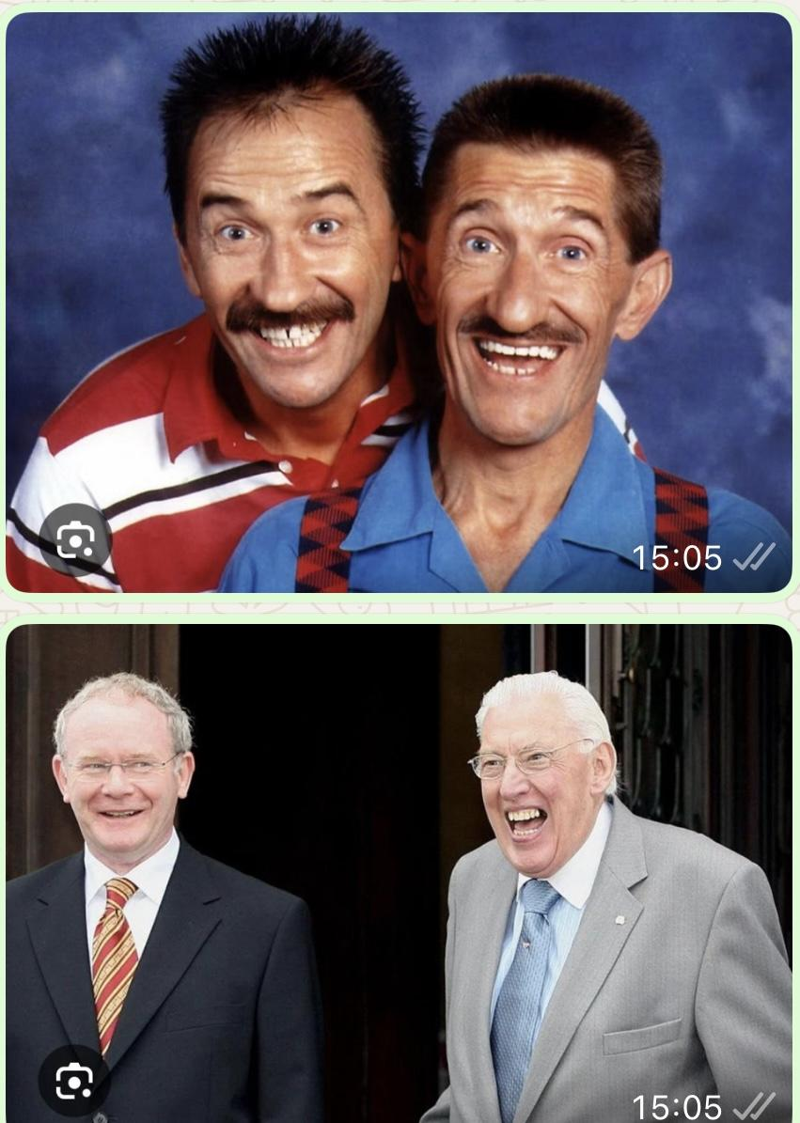

Slide 70
Plato's Charioteer (Phaedrus)
  Noble horse: Spirit/thumos—sense of honour, pride, righteous emotion
  Unruly horse: Appetite/epithymia—base desires and physical cravings
  Charioteer: Reason/logos—guides toward philosophical truth

Slide 71
Mapping Plato to Freud
The charioteer can be seen to map onto the ego, both being mediators trying to navigate reality while managing competing internal forces.
The charioteer balances the horses' different natures; the ego mediates between id and superego while dealing with external reality.

Slide 72
The Iliad: Internal Deliberation
Scene in the Iliad where Achilles engages in internal deliberation, speaking with his soul (psyche). He debates two possible life paths.
His mother Thetis prophesied he has two fates: stay at Troy, win eternal glory but die young; or return home for long, obscure life. He also debates whether to kill Agamemnon or restrain himself (ultimately does latter).
Internal conflicts could be read through a proto-Freudian lens.

Slide 73
Politics & The Double Persona
John McCain's 2008 concession speech: only gracious one of its kind ever heard
Rachel Reeves and Sir Keir seem to be making it up as they go along—adopting positions representing pragmatism of retaining power
New Labour in 1997 was first time this really reared up. Perhaps Kinnock to small extent. Mrs Thatcher had stiff creases ironed out. (Python story)

Slide 74
Democratic Celebration
Does the fact that politicians do not celebrate victories of opponents represent triumph of baser forces within them, over celebration that people have voted?
There is loud rhetoric that democracy is paramount. Should this not trump ephemeral disappointment of losing?

Slide 75
Socrates: Scepticism About Democracy
Socrates believed voting was a skill requiring knowledge and wisdom, not random intuition
Pessimistic about democracy—compared it to a ship where only skilled navigators should be in charge
Feared uneducated masses would be swayed by demagogues using charisma and empty promises
This leads to societal shipwreck

Slide 76
Jokes (1905)
Freud wrote a whole book about jokes and what they reveal. He felt jokes were a way of releasing expressed aggression in such a way you would not have to play out that aggression.
The humoristic context legitimised the cathartic expression of an unpleasant thought or emotion. Do I deserve opprobrium for telling an Irish joke?
Restaurant joke

Slide 77
Woke, Cancel Culture & Catharsis
This chimes extraordinarily with contemporary sensibilities and current argument about concepts loosely framed as 'woke' and 'cancel culture'.
Should Alf Garnett and the Major in Fawlty Towers be cancelled? Writers say humour is at the expense of the bigots, not concordant with their views.
On basis that claims are valid, the view that laughter is cathartic (betraying latent prejudice) might hold water.

Slide 78
A Freudian Joke
"My therapist says I have a preoccupation with vengeance. We'll see about that."
Very innocuous joke. Let us enjoy socially inappropriate aggressive thought by framing it as self-aware humour about therapy itself.

Slide 79
Behaviourism: There is LESS to us than we think
A counter-philosophy usually associated with John B. Watson (1878–1958) and B. F. Skinner (1904–1990).
These men posited the florid pretentiousness of Freud's convoluted theories about the 'inner life'.

Slide 80
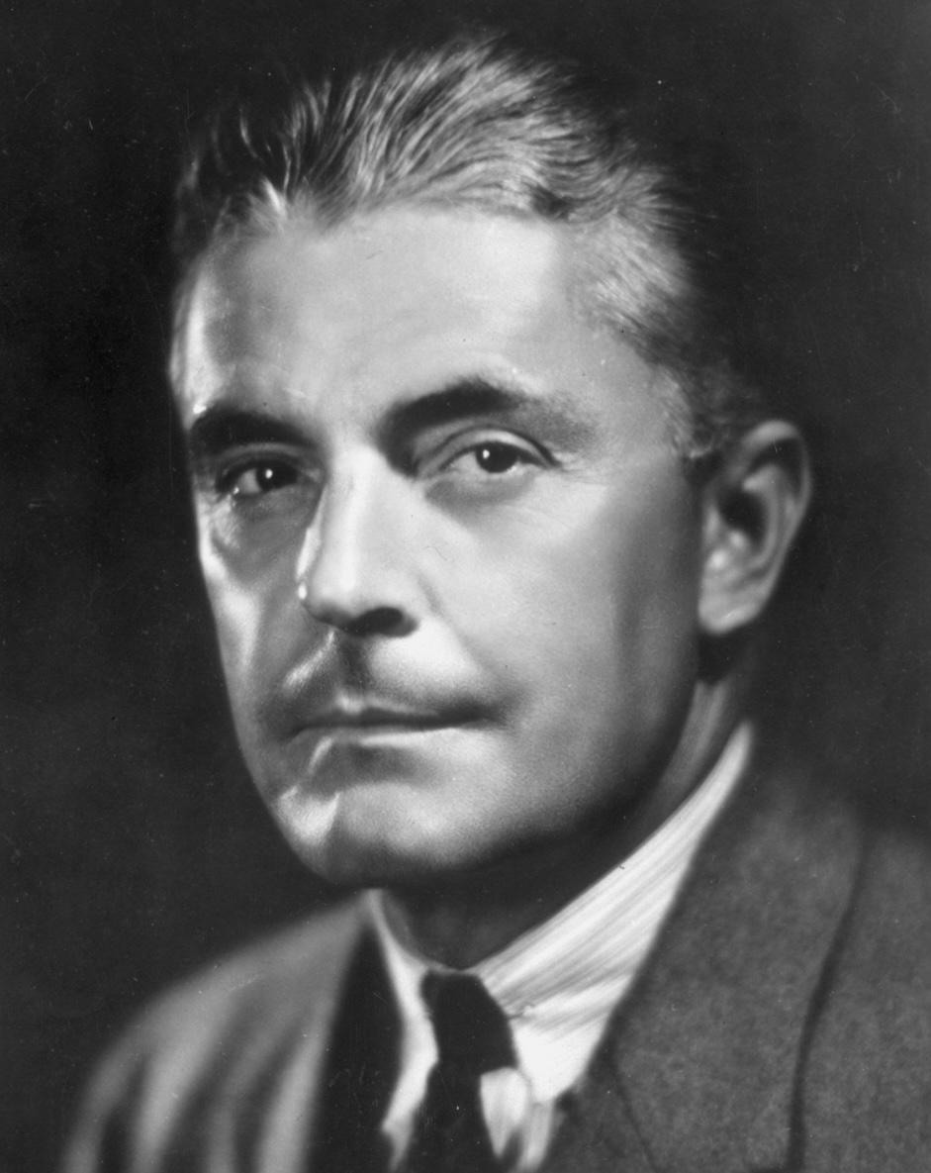
J. M. Watson

Slide 81
John B. Watson: Founder of Behaviourism
Psychology should focus only on observable behaviour, not consciousness or introspection
Rejected discussion of internal mental states or feelings as causes of behaviour
Called these things part of the "black box"
Viewed internal mental states as unnecessary to explain behaviour

Slide 82
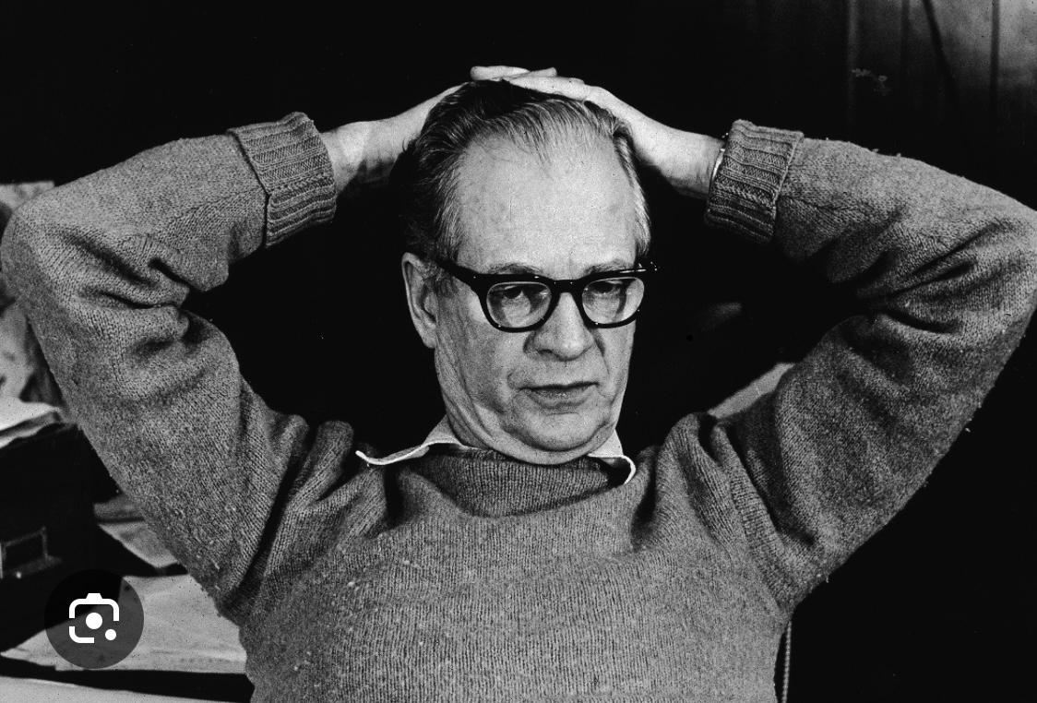
B. F. Skinner

Slide 83
B. F. Skinner's Model
Explained all behaviour by looking at: stimuli (what happens to us), responses (what we do), consequences (reinforcement or punishment).
While Freud looked below consciousness tip, seeing churn of unconscious repression, Skinner traduced this unhelpful conjecture.
Explained behaviour via observable environmental contingencies, not what he called invisible mental ghosts.

Slide 84
Internal States as Vague Language
To talk about internal states is vague, imprecise language describing behavioural patterns shaped by reinforcement history.
We are all aware of Pavlov's dogs and that pets respond to treats or punishment. Most dog owners think unless you treat them tough, you become the supplicant. Dogs have owners; cats have staff.

Slide 85
Skinner on Psychoanalysis Risks
Skinner believed dangers of psychoanalysis are tantamount to those engendered by an incompetent surgeon.
Given inherent suggestibility of many patients who choose Freudian enquiry, opportunities for charlatanism are tempting and lucrative in equal measure.

Slide 86
Simplicity's Double Edge
The simplicity of Skinner's philosophy is its attraction and its undoing. I am seeing barbarisms such as aversion therapy as having their roots in Skinner's discourse.

Slide 87
Defence Mechanisms & Survival
We sometimes jump on an interpretational bandwagon and fail to take account of defence mechanisms' role in survival. We need them.
We need to eat and concentrate on food, but must also be aware of predation and need to defend ourselves. One part of brain deals with job at hand; another, less visible, deals with contextual matters.

Slide 88
Political Leaders & Hidden Trauma
Vladimir Putin, Bibi Netanyahu, and Hamas leaders are each dealing with something. Do they fully understand antecedents of contexts in which they act? Do they comprehend consequences? Do any of us?
Are they able fully to place value on trauma and how it interlaces with geopolitics? I would love to know their dreams.

Slide 89
Personal Trauma & World Events
Freud would have argued that the actions of such men are attributable in some measure to their own pasts. It is sobering to think perhaps one man's maternal rejection and forgotten setbacks were causal to some degree of the Holocaust.

Slide 90
Hitler's Self-Reinforcing Delusion
Hitler engineered mechanisms (propaganda, ritual, spectacle, suppression of dissent) that produced crowd responses he consumed as external validation.
Each circle reinforces next: he creates conditions for acclaim, receives acclaim, interprets as independent verification of righteousness, emboldening more extreme actions, generating more orchestrated enthusiasm, spiralling inward toward concentrated delusion.
Something Dante-esque in this hellish concentricity.

Slide 91
Freud & Organised Religion
Freud was sceptical about organised religion, not least on grounds that clear mimesis going on in group worship situations.
There is hegemony exercised by majority that naturally inveigles some outsiders. Fashion in naming babies: very few called Cyril or Brian anymore. Parents genuinely feel these are ugly names, not noticing aesthetic judgment not independently wrought.

Slide 92
Pascal's Wager
Pascal (a Jansenist) exhorted faith in Christ to cynics: Christians go to heaven, everyone else to hell. It's a win/win. If Christianity untrue, you've lost nothing.
Yet obviously, one possible outcome never occurs to him: What if another exclusive religion is true, and not Christianity?
Blaise Pascal was serious theologian, but I feel his rationale was flawed.

Slide 93
Logical Flaws
All cows are animals; some animals eat grass. Therefore, some cows eat grass.
Sounds terribly plausible and logically tight, but is flawed. I do see Pascal's wager as shtik too. He was a man with fine mind whose belief structures were clearly refracted by circumstance.

Slide 94
Religious Conversion & Social Matrix
Many people convert to particular religious belief within social matrix or framework. Billy Graham rallies were good example.
Yet imagine someone marooned on desert island, never hearing any religion. One day Bible washes up; next day Quran. Then five further books that week. Castaway reads them all with interest.
My contention is very few people would make religious commitment based on that scenario. Everything depends on particular circumstances and human persuaders.

Slide 95
We Are Engaged in Constant Mimesis
If we extend this drift to personality and behaviour, we are all engaged in constant mimesis. On basis of this view, I believe we float on the wind.
I have hinted at the possibility that religious faith owes itself to hegemony. Think also of mimesis that seems part of human condition.

Slide 96
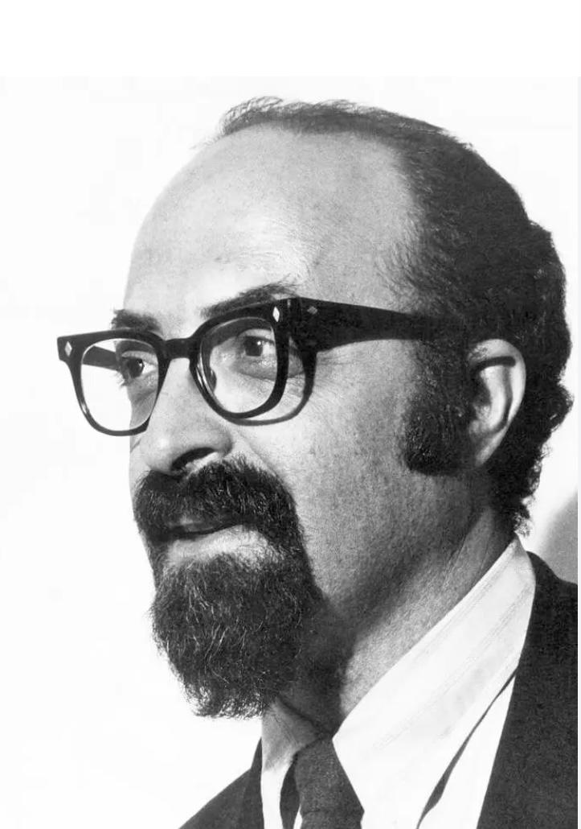
Chaim Potok

Slide 97
Personal Journey
The person that I am and the possibilities that might have resulted from a different set of circumstances. My Judaism is very different from that of my cousins.
Chaim Potok’s novel, The Chosen

Slide 98
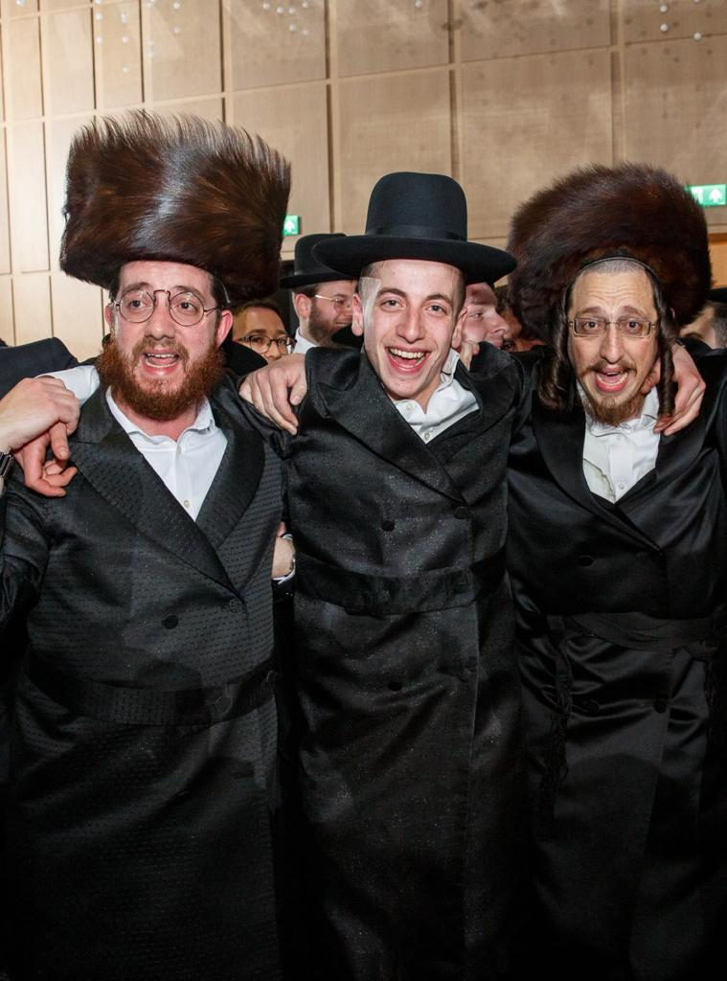

Slide 99
Pascal's Blindness as Defence Mechanism
I see Pascal's blindness to syllogistic truth as obvious defence mechanism. The notion that Christians can have their stake back in event of being wrong, but others cannot, is clearly not befitting his towering intellect.

Slide 100
Football Allegiance
Although I have in some sense self-administered Freudian analysis and seen random absurdity of my affiliation to a certain club, this has not straightened out emotions associated with defeat or victory.

Slide 101
The Plagiarism Paradox
I am fascinated by concept of plagiarism, which is pejorative—implying underhand copying. What on earth would an 'unplagiarised' person look like? (Sartre’s Roquentin in La Nausée)
Nobody impugns better teachers having better pupils able to write good exam answers in plagiarism of that teacher. Mastery in one context and plagiarism in another. The distinction hinges on something nebulous.

Slide 102
Creative Influence
Beethoven's music emerges from Haydn, Mozart and Mannheim school
Beatles derived from Chuck Berry, Little Richard and Carl Perkins
We don't call this plagiarism even though output derived from borrowed elements, recombined
Cannot call this disingenuous. These musicians were part of continuum
No lack of authenticity for that

Slide 103
Taking This to Personality & Behaviour
We are all engaged in constant mimesis—learning social scripts, copying mannerisms, internalising values and patterns from environment.
Freud's concern isn't just about authenticity in abstract sense but psychological health: when does adaptive social learning become pathological identification? When does necessary ego-formation through imitation result in self that is more echo than voice?
Something troubling about extent to which what we call 'ourselves' might be largely assemblage of unacknowledged plagiarisms.

Slide 104
Jacques Lacan
(1901–1981)
Seen as successor to Freud. Lacan did not so much advocate excavation of psyche as therapeutic goal of hypnosis. Rather, concentrated on distinction between self-identified by person and self as seen by others.
Language itself took people into areas of themselves not previously seen.

Slide 105
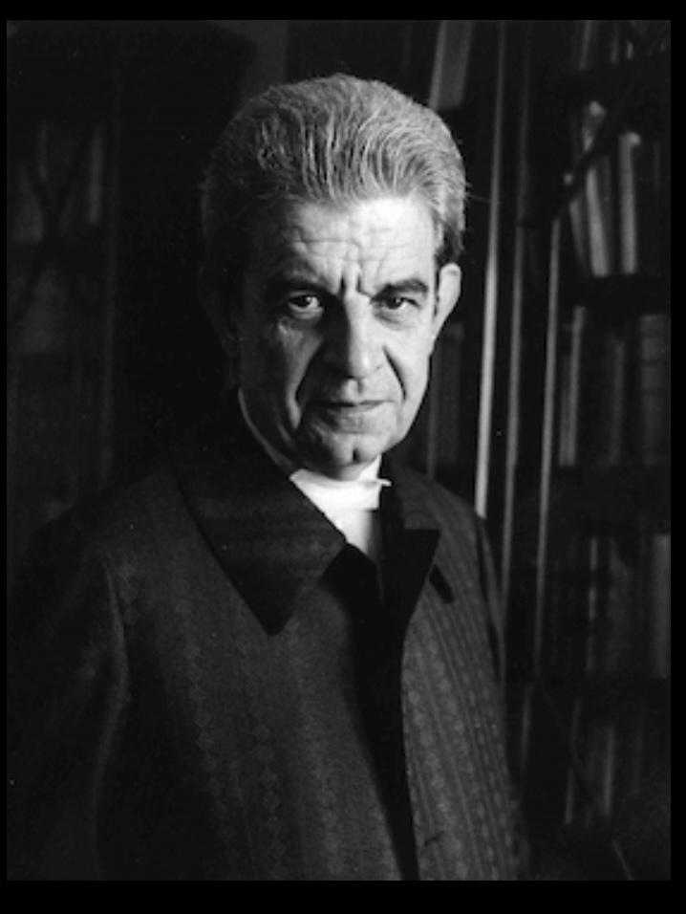
Jacques Lacan

Slide 106
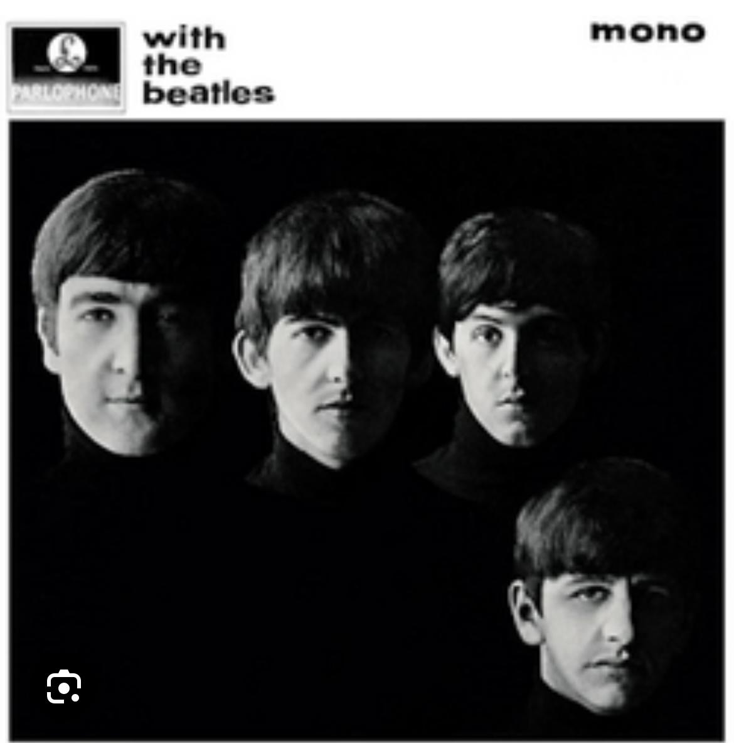

Slide 107
The Split Subject
As soon as child learns first person singular pronouns (I, me), they are learning to represent themselves through signifier (word). The split: 'I' who speaks is never quite the same as 'I' being spoken about.
Dichotomy between subject of enunciation and subject of statement. Like surprise we get hearing recording of ourselves speaking or looking in mirror.

Slide 108
Thanatos:
The Death Drive
Takes me back to 'death drive' in Beyond the Pleasure Principle (1920). Represents something darker and more baffling than repressed sexual desire.
Freud meant silent drive towards dissolution and return to inorganic state—way of undoing tensions of life itself. Obviously appears counter-intuitive to any understanding of survival instinct.
I’d argue that therenis something expoloratory and normal in some forms of masochism. Tooth wiggling, for example.

Slide 109
Repetition Compulsion
In putative corroboration, Freud observed repetition compulsion: trauma victims replaying their trauma and people sabotaging their own happiness.
I remain unconvinced and believe some forms and levels of masochism are part of human condition, simply as part of experimenting and explorational aspect of life.

Slide 110
Sigmund's Grandsons: Lucian & Clement
People ask whether there are observable traits passed down by Sigmund to his famous grandsons, Lucian and Clement. Bit of a stretch, though intriguing.
Lucian's nudes reveal flesh with honesty that can be uncomfortable. Willingness to look at what others turn away from and proclivity to looking beneath human mask.
Clement's ability to observe human absurdity connects to psychoanalytic sensibility.

Slide 111
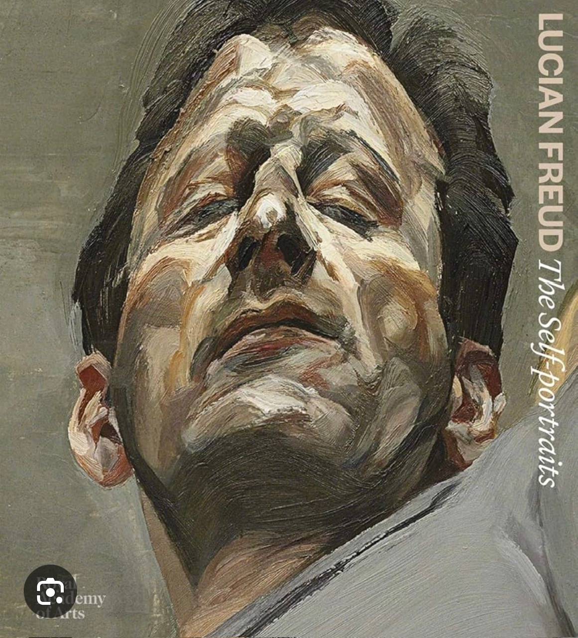
Lucian

Slide 112
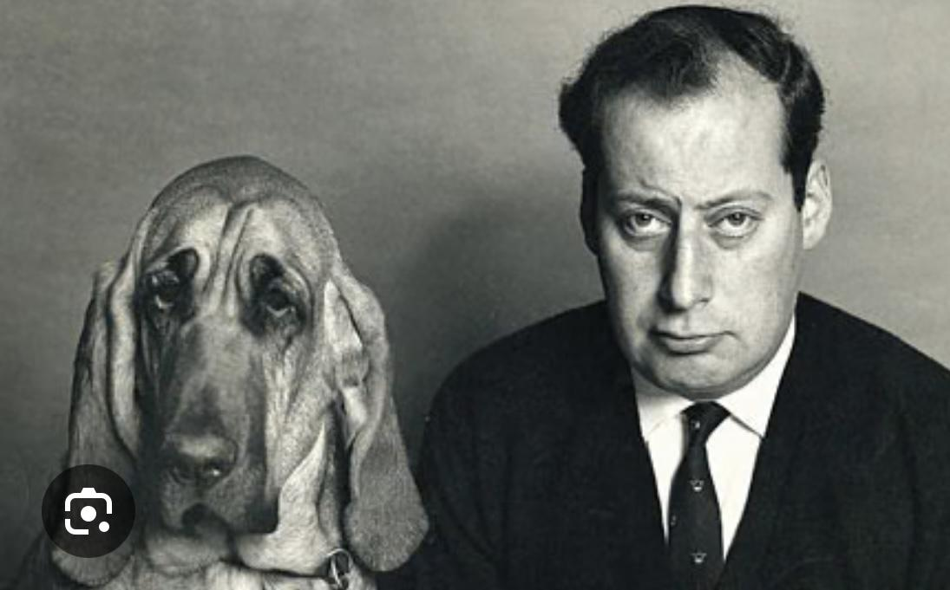
Clement

Slide 113
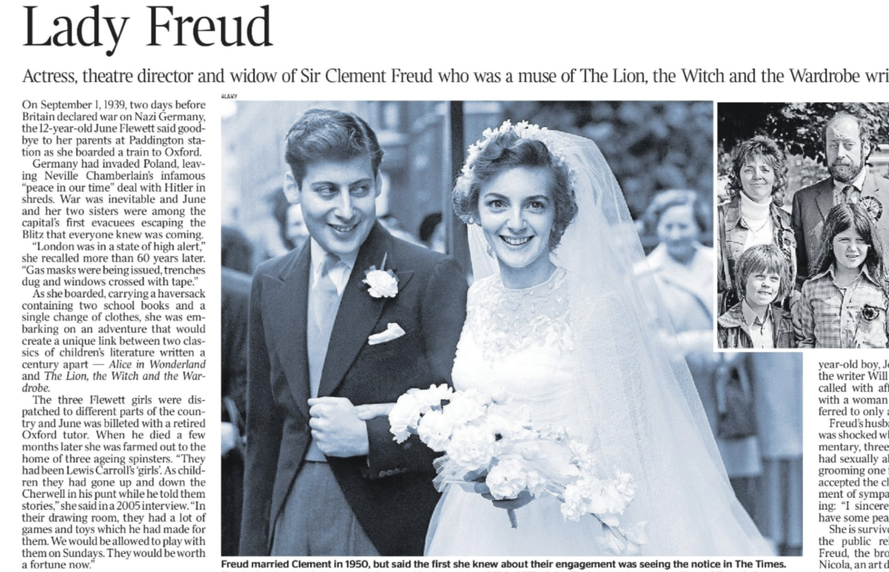

Slide 114
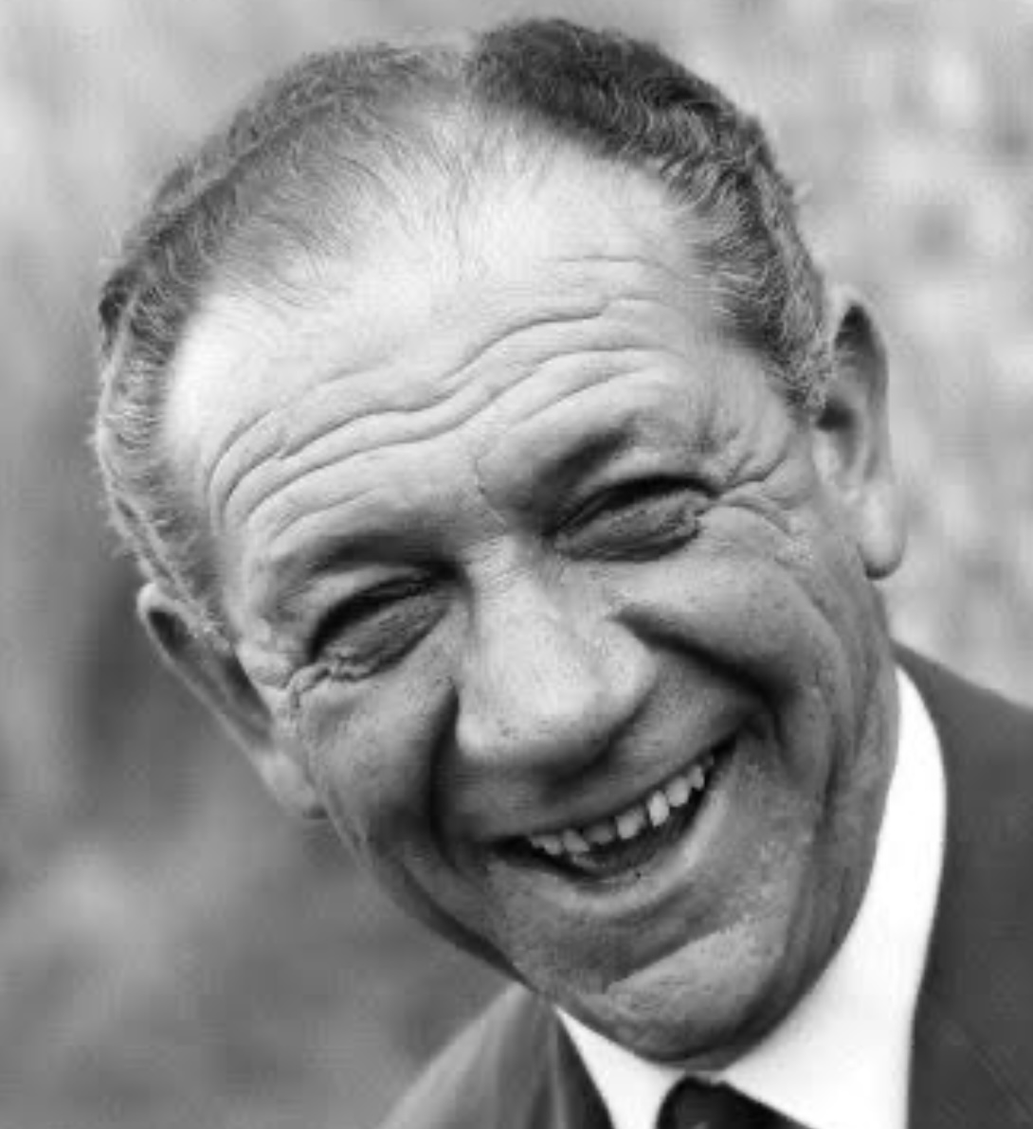

Slide 115
Conclusion
Is there more to us than we think?
Or perhaps, less than we think?
Either way, we are far more complex and mysterious than conscious reflection reveals.

